Slide 1




Java: Syntax, Basic Web
Conditions, Loops, Methods, Objects, Collections, Spring MVC
Java
Spring
SoftUni Team
Technical Trainers
Software University
http://softuni.bg

Slide 2


Table of Contents
Java Syntax
Variables and Operators
Conditions: if-else, switch
Loops: for, while, do-while, …
Methods, parameters, return value
Objects and Classes
Arrays and Collections: ArrayList, Map, Set
Java Web with Spring MVC

Slide 3
Have a Question?
sli.do #tech-softuni

Slide 4

Welcome to Java!
IDEs, Comparison, Basic Syntax

Slide 5

Welcome to Java
Java is a statically-typed, object-oriented programming language
Very similar to C#, but less flexible
Programs are compiled before execution
Variables' types cannot be changed
In contract, JavaScript and PHP are dynamically-typed (scripting) languages
Can work in interactive mode (REPL)
No compilation, just execute commands

Slide 6
Hello World in Java
HelloJava class always stays in a file named HelloJava.java
HelloJava.java
The { stays at the same line
public class HelloJava {
public static void main(String[] args) {
System.out.println("Hello Java!");
}
}
Program entry point: main() method

Slide 7
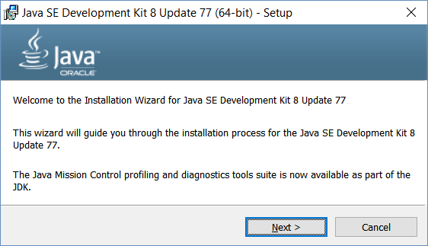
Installing Java
Download and install Java 8 SDK (JDK 8)
http://oracle.com/technetwork/java/javase/downloads/
Provides runtime environment (JRE) + compilers + tools
JRE (Java Runtime Environment)
https://java.com/en/download/
JRE is for end-users, not for devs
Developers should use JDK

Slide 8
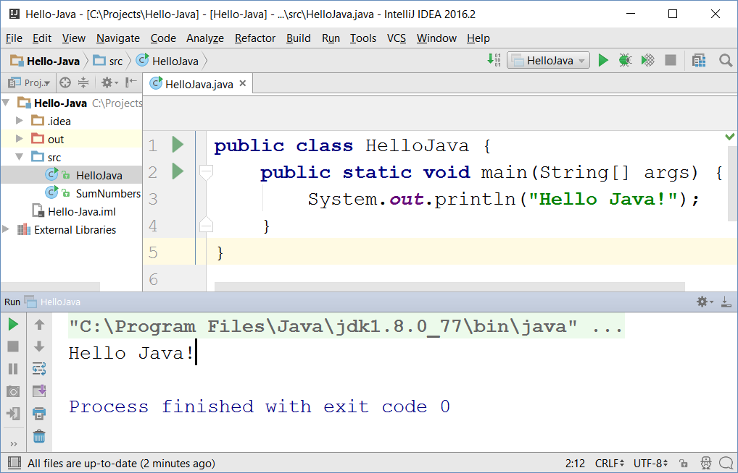

IntelliJ IDEA
JetBrains IntelliJ IDEA
Powerful Java IDE
Community edition (free)
Ultimate edition (commercial)

Slide 9
Java Basic Syntax
Variables, Operators

Slide 10
Variables and Operators in Java
Play with Java online:
www.javarepl.com
Define variables by their type
int i = 5; double d = 3; // i is integer, d is double
System.out.println(i + " ; " + d); // 5 ; 3.0
d = i * d; d++; // d = 16.0
System.out.println(d + 1); // 17.0
The ; separates multiple statements
String str = "Hello";
str = str + " Java";
System.out.printf("str = %s", str); // str = Hello Java
The %s is a string placeholder
System.out.print(s); // Compilation error: unknown symbol s

Slide 11
Problem: Calculate Expression
Write a Java program to calculate and print the value of the following expression: [(30 + 21) * 1/2 * (35 - 12 - 1/2)]²
Sample solution:
double val = (30 + 21) * 1/2.0 * (35 - 12 - 1/2.0);
double valSquare = val * val;
System.out.println(valSquare);
Check your solution here: https://judge.softuni.bg/Contests/Practice/Index/264#0

Slide 12
Problem: Sum Two Numbers
Write a Java program to sum two real numbers:
import java.util.Scanner;
public class SumTwoNumbers {
public static void main(String[] args) {
Scanner scan = new Scanner(System.in);
double num1 = scan.nextDouble();
double num2 = scan.nextDouble();
System.out.printf("Sum = %.2f", num1 + num2);
}
}
Check your solution here: https://judge.softuni.bg/Contests/Practice/Index/264#1

Slide 13
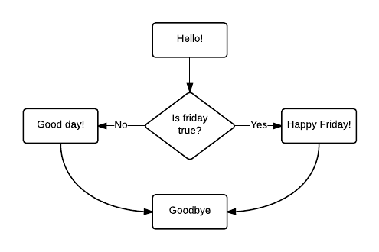
Conditional Statements
If/else, switch case

Slide 14
Conditions: if-else Statement
Java implements the classical if / if-else statements:
int number = 5;
if (number % 2 == 0) {
System.out.println("Even number");
}
else {
System.out.println("Odd number");
}

Slide 15
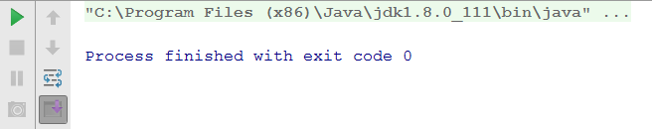
Beware of Comparing Strings
String s = "sho"; if ("Pesho" == "Pe" + s) { System.out.println("Здрасти, Пешо!"); }

Slide 16
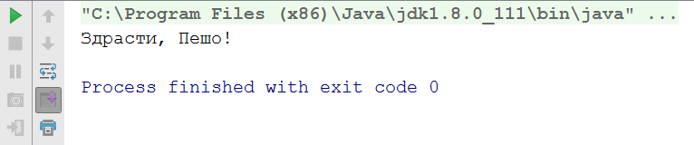
Beware of Comparing Strings (2)
Always use .equals() for string comparison!
String s = "sho"; if ("Pesho".equals("Pe" + s)) { System.out.println("Здрасти, Пешо!"); }

Slide 17
Problem: Three Integers Sum
You are given 3 integers
Check whether the sum of two of them is equal to the third
Print the output in format a + b = c (where a ≤ b)
8 15 7
7 + 8 = 15
3 8 12
No
-5 -3 -2
-3 + -2 = -5
0 0 0
0 + 0 = 0
Check your solution here: https://judge.softuni.bg/Contests/Practice/Index/264#2

Slide 18
Solution: Three Integers Sum
public static void main(String[] args) {
Scanner scan = new Scanner(System.in);
int num1 = scan.nextInt();
int num2 = scan.nextInt();
int num3 = scan.nextInt();
if (!checkThreeIntegers(num1, num2, num3) &&
!checkThreeIntegers(num3, num1, num2) &&
!checkThreeIntegers(num2, num3, num1))
System.out.println("No");
}
Check your solution here: https://judge.softuni.bg/Contests/Practice/Index/264#2

Slide 19
Solution: Three Integers Sum (2)
static boolean checkThreeIntegers(
int num1, int num2, int sum) {
if (num1 + num2 != sum)
return false;
if (num1 <= num2)
System.out.printf("%d + %d = %d\n", num1, num2, sum);
else
System.out.printf("%d + %d = %d\n", num2, num1, sum);
return true;
}
Check your solution here: https://judge.softuni.bg/Contests/Practice/Index/264#2

Slide 20
The switch-case Statement
Selects for execution a statement from a list depending on the value of the switch expression
int day = 3;
switch (day) {
case 1: System.out.println("Monday"); break;
case 2: System.out.println("Tuesday"); break;
case 3: System.out.println("Wednesday"); break;
…
case 7: System.out.println("Sunday"); break;
default: System.out.println("Error!"); break;
}

Slide 21

Loops
For, while, do-while

Slide 22
Loops: for, while, do-while, …
The for / while / do-while loops work as in C++, C# and Java
for (int i = 0; i <= 10; i++)
System.out.println(i); // 0 1 2 3 4 … 10
int count = 1;
while (count < 1024)
System.out.println(count *= 2); // 2 4 8 … 1024
String s = "ha";
do { System.out.println(s); s = s + s; }
while (s.length() < 10); // ha haha hahahaha

Slide 23
Problem: Sum N Integers in Java
import java.util.Scanner;
public class SumIntegers {
public static void main(String[] args) {
Scanner scan = new Scanner(System.in);
int n = scan.nextInt();
long sum = 0;
for (int i = 0; i < n; i++)
sum += scan.nextInt();
System.out.println("Sum = " + sum);
}
}
5
10
20
30
40
-1
99
Check your solution here: https://judge.softuni.bg/Contests/Practice/Index/264#3

Slide 24
Problem: Symmetric Numbers
Write a Java program that finds and prints all symmetric numbers in the range [1…n]
1 2 3 4 5 6 7 8 9 11 22 33 44 55 66 77 88 99 101 111 121 131 141 151 161 171 181 191 202 212 222 232 242 252 262 272 282 292 303 313 323 333 343 353 363 373 383 393 404 414 424 434 444 454 464 474 484 494 505 515 525 535 545 555 565 575 585 595 606 616 626 636 646 656 666 676 686 696 707 717 727 737 747
750
Check your solution here: https://judge.softuni.bg/Contests/Practice/Index/264#4

Slide 25
Solution: Symmetric Numbers
public static void main(String[] args) {
Scanner scan = new Scanner(System.in);
int n = scan.nextInt();
for (int i = 1; i <= n; i++)
if (isSymmetric("" + i))
System.out.print(i + " ");
}
static boolean isSymmetric(String str) {
for (int i = 0; i < str.length() / 2; i++)
if (str.charAt(i) != str.charAt(str.length() - i - 1))
return false;
return true;
}
Check your solution here: https://judge.softuni.bg/Contests/Practice/Index/264#4

Slide 26
Methods in Java
Methods in Java hold a named piece of code
Can take parameters and return a result (strongly typed!)
Similar to functions in C / PHP / JS and methods in C++ / C#
static makes the method callable from main()
static int multiply(int a, int b) {
return a * b;
}
System.out.println(multiply(2, 3)); // 6 == 2 * 3
System.out.println(multiply(5)); // Compilation error

Slide 27
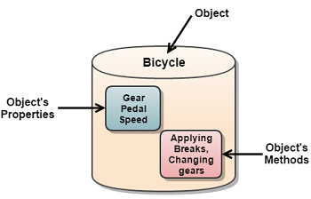
Objects and Classes
Definition, usage

Slide 28

Objects
In programming objects holds a set of named values
E.g. a rectangle object holds width and height
Creating a rectangle object:
Object name
rectangle
width = 5
height = 4
Object properties
The new operator creates a new object
Rectangle rectangle = new Rectangle(5, 4);

Slide 29
Defining Classes
Rectangle.java
public class Rectangle {
private int width;
private int height;
public Rectangle(int width, int height) {
this.width = width;
this.height = height;
}
public int getWidth() { return width; }
public void setWidth(int width) { this.width = width; }
public int getHeight() { return height; }
public void setHeight(int height) { this.height = height; }
}
Class declaration
Fields
Getters and setters
Constructor

Slide 30
Methods in Classes
Rectangle.java
public class Rectangle {
…
public long area() {
return this.width * this.height;
}
@Override
public String toString() {
return String.format(
"Rect[width=%d, height=%d]",
this.width, this.height);
}
}
Class method (non-static)
toString() returns a text representation of the object

Slide 31
Using Classes
Rectangle smallRect = new Rectangle(5, 4);
System.out.println(smallRect); // Rect[width=5, height=4]
System.out.println("Area: " + smallRect.area()); // Area: 20
Rectangle bigRect = new Rectangle(100, 80);
System.out.println(bigRect); // Rect[width=100, height=80]
System.out.println("Area: " + bigRect.area()); // Area: 8000
bigRect.setWidth(bigRect.getWidth() * 2);
bigRect.setHeight(bigRect.getHeight() * 2);
System.out.println(bigRect); // Rect[width=200, height=160]
System.out.println("Area: " + bigRect.area()); // Area: 32000

Slide 32
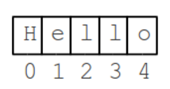
Strings

Slide 33

Strings
Strings in Java
Know their number of characters: length()
Can be accessed by index: charAt(0 … length()-1)
Reference types
Stored in the heap (dynamic memory)
Can have null value (missing value)
Strings cannot be modified (immutable)
Most string operations return a new String instance
StringBuilder class is used to build stings

Slide 34
Strings – Examples
String str = "SoftUni";
System.out.println(str);
for (int i = 0; i < str.length(); i++) {
System.out.printf("str[%d] = %s\n", i, str.charAt(i));
}
System.out.println(str.indexOf("Uni")); // 4
System.out.println(str.indexOf("uni")); // -1 (not found)
System.out.println(str.substring(4, 7)); // Uni
System.out.println(str.replace("Soft", "Hard")); // HardUni
System.out.println(str.toLowerCase()); // softuni
System.out.println(str.toUpperCase()); // SOFTUNI

Slide 35
Strings – Examples (2)
String firstName = "Steve";
String lastName = "Jobs";
int age = 56;
System.out.println(firstName + " " + lastName +
" (age: " + age + ")"); // Steve Jobs (age: 56)
String allLangs = "C#, Java; HTML, CSS; PHP, SQL";
String[] langs = allLangs.split("[, ;]+");
for (String lang : langs) {
System.out.println(lang);
}
System.out.println("Langs = " + String.join(", ", langs));
System.out.println(" \n\n Software University ".trim());

Slide 36
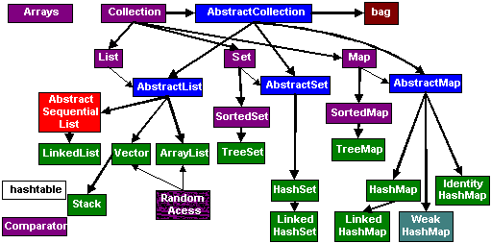
Collections
Arrays, ArrayList<>, HashSet<>, etc.

Slide 37
Arrays in Java
// Array holding numbers
int[] numbers = {1, 2, 3, 4, 5};
System.out.println(Arrays.toString(numbers));
// Array holding strings
String[] weekDays = {"Monday", "Tuesday", "Wednesday",
"Thursday", "Friday", "Saturday", "Sunday"};
// Array of mixed data (objects)
Object[] mixedArr = {1, new Date(), "hello"};
// Array of arrays of strings (matrix)
String[][] matrix = {
{"0,0", "0,1", "0,2"},
{"1,0", "1,1", "1,2"}};

Slide 38
Processing Array Elements
String[] capitals =
{"Sofia", "Berlin", "London", "Paris", "Moscow"};
capitals[0] = "SOFIA";
capitals[4] = null;
System.out.println(Arrays.toString(capitals));
// [SOFIA, Berlin, London, Paris, null]
for (String capital : capitals)
System.out.println(capital);
for (int i = 0; i < capitals.length; i++)
System.out.println(capitals[i]);
Traditional foreach loop
Traditional for-loop

Slide 39
Problem: Largest 3 Numbers
Write a program to read an array of numbers and find and print the largest 3 of them
10 30 15 20 50 5
20 30
10 5 20 3 20
50 30 20
30 20
20 20 10
Check your solution here: https://judge.softuni.bg/Contests/Practice/Index/264#5

Slide 40
Solution: Largest 3 Numbers
int[] nums = Arrays.stream(
new Scanner(System.in).nextLine().split(" "))
.mapToInt(Integer::parseInt).toArray();
Arrays.sort(nums);
int count = Math.min(3, nums.length);
for (int i = 0; i < count; i++)
System.out.print(nums[nums.length - i - 1] + " ");
Java Stream API - similar to LINQ in C#
Check your solution here: https://judge.softuni.bg/Contests/Practice/Index/264#5

Slide 41
Collections: ArrayList<String>
ArrayList<String> names = new ArrayList<String>() {{
add("Peter");
add("Maria");
add("Katya");
add("Todor");
}};
names.add("Nakov"); // Peter, Maria, Katya, Todor, Nakov
names.remove(0); // Maria, Katya, Todor, Nakov
names.remove(1); // Maria, Todor, Nakov
names.remove("Todor"); // Maria, Nakov
names.addAll(Arrays.asList("Alice", "Tedy"));
// Maria, Nakov, Alice, Tedy
names.add(3, "Sylvia"); // Maria, Nakov, Alice, Sylvia, Tedy
names.set(2, "Mike"); // Maria, Nakov, Mike, Sylvia, Tedy
System.out.println(names);

Slide 42
Collections: ArrayList<Integer>
// This will not compile!
ArrayList<int> intArr = new ArrayList<int>();
ArrayList<Integer> nums = new ArrayList<>(
Arrays.asList(5, -3, 10, 25));
nums.add(55); // 5, -3, 10, 25, 55
System.out.println(nums.get(0)); // 5
System.out.println(nums); // [5, -3, 10, 25, 55]
nums.remove(2); // 5, -3, 25, 55
nums.set(0, 101); // 101, -3, 25, 55
System.out.println(nums); // [101, -3, 25, 55]

Slide 43
HashSet<E> and TreeSet<E>
Set<String> set = new TreeSet<String>();
set.add("Pesho");
set.add("Tosho");
set.add("Pesho");
set.add("Gosho");
set.add("Maria");
set.add("Alice");
set.remove("Pesho");
System.out.println(set); // [Alice, Gosho, Maria, Tosho]

Slide 44
Collections: Maps in Java
Maps in Java keep unique <key, value> pairs
HashMap<K, V>
Keeps a map of elements in a hash-table
The elements are randomly ordered (by their hash code)
TreeMap<K, V>
Keeps a set of elements in a red-black ordered search tree
The elements are ordered incrementally by their key

Slide 45
HashMap<K, V> – Examples
Counting words occurrences in a list:
String[] words = { "yes", "hi", "hello", "hi", "welcome",
"yes", "yes", "welcome", "hi", "yes", "hello", "yes" };
Map<String, Integer> wordsCount = new HashMap<String, Integer>();
for (String word : words) {
Integer count = wordsCount.get(word);
if (count == null) {
count = 0;
}
wordsCount.put(word, count+1);
}
System.out.println(wordsCount); // {hi=3, yes=5, hello=2, welcome=2}

Slide 46
TreeMap<K, V> – Examples
Students and their grades
HashMap<String, ArrayList<Integer>> grades = new HashMap<>();
grades.put("Peter", new ArrayList<>(Arrays.asList(5)));
grades.put("George", new ArrayList<>(Arrays.asList(5, 5, 6)));
grades.put("Maria", new ArrayList<>(Arrays.asList(5, 4, 4)));
grades.get("Peter").add(6);
grades.get("George").add(6);
for (String key : grades.keySet()) {
System.out.println("" + key + " -> " + grades.get(key));
}

Slide 47
Problem: Sums by Town
You are given a sequence of lines, each holding town + income
Write a Java program to sum the incomes for each town
4
Sofia | 200
Varna | 120
Pleven | 60
Varna | 70
Towns can appear multiple times
Pleven -> 60.0
Sofia -> 200.0
Varna -> 190.0
Order the towns by name
Check your solution here: https://judge.softuni.bg/Contests/Practice/Index/264#6

Slide 48
Solution: Sums by Town
TreeMap<String, Double> sumsByTown = new TreeMap<>();
for (int i = 0; i < n; i++) {
String[] tokens = scanner.nextLine().split("\\|");
String town = tokens[0].trim();
double income = Double.parseDouble(tokens[1].trim());
if (sumsByTown.containsKey(town)) {
sumsByTown.put(town, sumsByTown.get(town) + income);
} else {
sumsByTown.put(town, income);
}
}
for (String key : sumsByTown.keySet()) {
System.out.println(key + " -> " + sumsByTown.get(key));
}
Check your solution here: https://judge.softuni.bg/Contests/Practice/Index/264#6

Slide 49



Java Web
Hibernate, Spring MVC, Thymeleaf

Slide 50

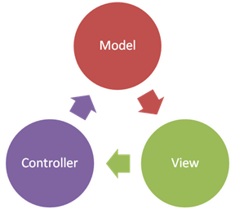

Spring MVC
Open Source Web MVC framework
Developed by Pivotal Software
Configuration with Spring Boot
Convention-over-configuration
Rapid application development
Create production-grade applications that you can “just run”
Automatically configure Spring

Slide 51
Spring Annotations
Spring uses strongly-typed Annotations
Syntax highlighting + error checking
@Annotation describes the code below it
@Controller
public class HomeController {
…
}
Versatile Access Control
@PreAuthorize("hasRole('ROLE_ADMIN')")
public String adminPanel(Model model) {
…
}

Slide 52
Spring Controllers
Defined with the @Controller annotation:
Controllers can contain multiple actions on different routes.
@Controller
public class HomeController {
…
}

Slide 53
Controller Actions
Annotated with with @RequestMapping(…)
Or
@RequestMapping("/home")
public String home() {
return "home-view";
}
@GetMapping("/home")
public String home(Model model) {
model.addAttribute("view", "home");
return "base-layout";
}

Slide 54
Processing GET Requests
Easier way to create route for a GET request:
This is alias for RequestMapping with method GET
@GetMapping("/home")
public String home() {
return "home-view";
}

Slide 55
Processing POST Requests
Similar to the GetMapping there is also an alias for RequestMapping with method POST:
Similar annotations exist for all other types of request methods
@PostMapping("/register")
public String register() {
…
}

Slide 56

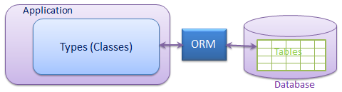

Hibernate ORM
Object-Relational Mapping (ORM) Framework for Java
Replace DB query access with object functions
Persistence
Change object in-memory ➔ changes it in DB
Add object to collection ➔ add it to DB
High Performance
Lazy-loading
Eager loading by request

Slide 57
Hibernate: Model - Fields
Classic Java OOP with Hibernate annotations:
@Entity
@Table(name = "users")
public class User {
private Integer id;
private String email;
private String fullName;
private String password;
}

Slide 58
Hibernate: Model - Properties
Classic Java OOP with Hibernate annotations:
@Column(name = "email", unique = true, nullable = false)
public String getEmail() {
return email;
}
public void setEmail(String email) {
this.email = email;
}

Slide 59


Thymeleaf
Thymeleaf is a view engine used in Spring
It allows us to:
Use variables/collections in our views
Execute operations on our variables
Iterate over collections
Notes:
http://www.thymeleaf.org/doc/tutorials/3.0/usingthymeleaf.html

Slide 60
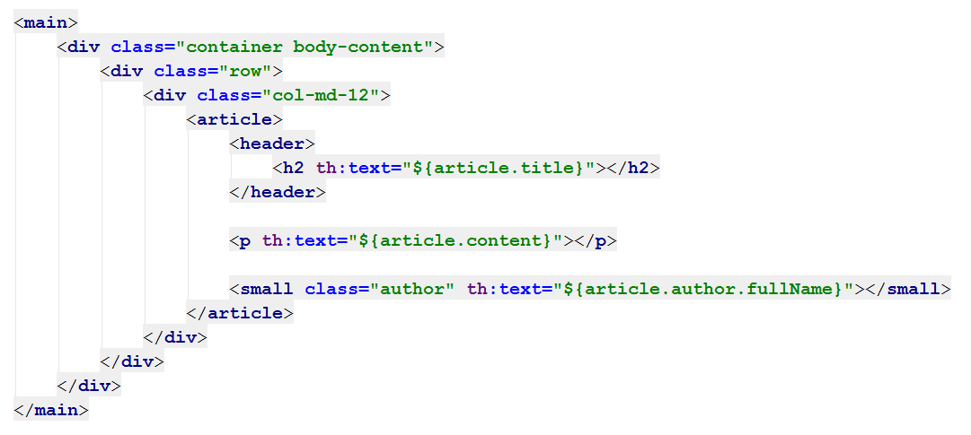
Thymeleaf: View Templates
Thymeleaf syntax
HTML
Syntax
Thymeleaf syntax
Thymeleaf syntax

Slide 61
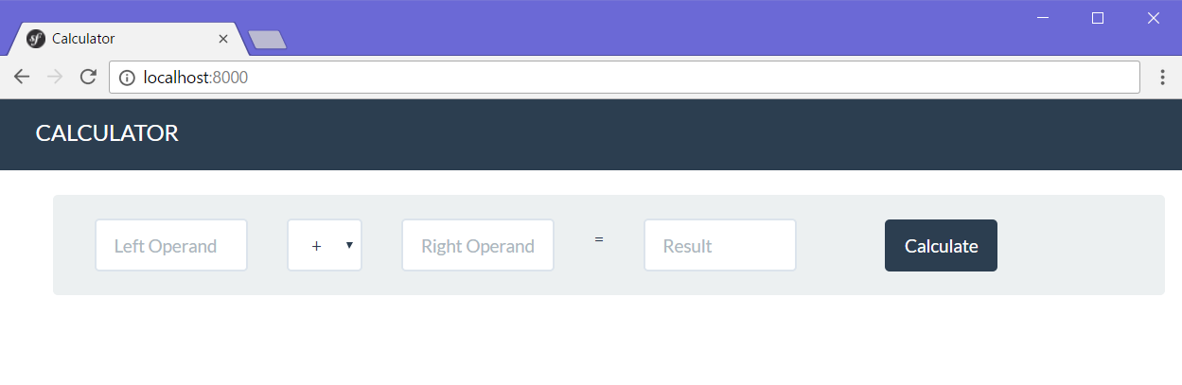
Web application with Spring MVC
Live Exercises in Class (Lab)

Slide 62

Summary
Java is a statically-typed language
Java programs consist of classes
Program logic (variables, conditions, loops) are similar to C# / C++ / PHP / JavaScript
Arrays in Java hold sequences of elements
Java collections: list, set, map { key → value}
Objects in Java are class instances
Java is object-oriented language: relies on objects, classes, interfaces, methods, etc.

Slide 63
Summary (2)
Build robust web applications with Java, using
Spring MVC
Open Source Web Framework for Java
Controller handling, annotations
Hibernate
ORM framework for Java
Thymeleaf
Powerful view engine
Variables, Iteration, Conditions

Slide 64








Java: Syntax, Basic Web
https://softuni.bg/courses/software-technologies

Slide 65
License
This course (slides, examples, demos, videos, homework, etc.) is licensed under the "Creative Commons Attribution-NonCommercial-ShareAlike 4.0 International" license

Slide 66





Trainings @ Software University
Software University Foundation – softuni.org
Software University – High-Quality Education, Profession and Job for Software Developers
softuni.bg
Software University @ Facebook
facebook.com/SoftwareUniversity
Software University Forums – forum.softuni.bg

